Slide 1
High-Value Asset Tracking using Bluetooth Low Energy Beacons in Hospital Environment
Team Blue Crew
December 2014

Slide 2
Key Points
Application service
Technology Stack
Application Platform
Facility devices
Business model
Demo description

Slide 3
IoT App Technology Stack
Smart Product Applications
Bluemix
Rules/Analytics Engine: rule algorithms,
data analysis, business logic
App Platform: data access, visualize, runtime tools
Asset database – store, groom, manage
Wide Area Network Connectivity
WAN: Cell/Non-Cell/Wired
Hospital
Facility
Asset/Patient Location Networks
2nd Device Layer: Gateway & Location Networks
(Where + When) + Who
WLAN BLE
1st Device Layer - BLE Beacons (Who I am)
Based on HBR Nov 2014 Porter and Heppelmann

Slide 4
User Application Working Flow
App
Use UUID or name to search for the device
Bluemix
Search receiver data service to find the device
Get access to the receiver which receives the device signal

Slide 5
Receiver Application Working Flow
Receiver
iOS device
Bluemix Receiver Data Service
Data storage
Receive the signal of Device

Slide 6
Smartphone Application Structure
Location
Movement
Storage check
UUID input
Name input

Slide 7
Data Storage Structure
Device number
UUID
name
receiver
Location
Time

Slide 8
Physical Device Layers
Smart Product Applications
Bluemix
Rules/Analytics Engine: rule algorithms,
data analysis, business logic
App Platform: data access, visualize, runtime tools
Asset database – store, groom, manage
Wide Area Network Connectivity
WAN: Cell/Non-Cell/Wired
Hospital
Facility
Asset/Patient Location Networks
2nd Device Layer: Gateway & Location Networks
(Where + When) + Who
WLAN BLE
1st Device Layer - BLE Beacons (Who I am)

Slide 9
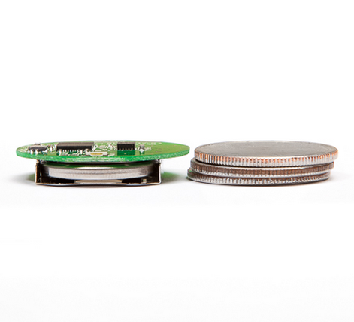

1st Layer Device Network
BKON A1 and D1 Bluetooth Low Energy (BLE) Beacons
Attached to patients and equipment
Long battery life ~ one year
Small footprint and size
Relatively low cost
Communicates unique ID number
BKON A1 Beacon
BKON D1 Beacon

Slide 10
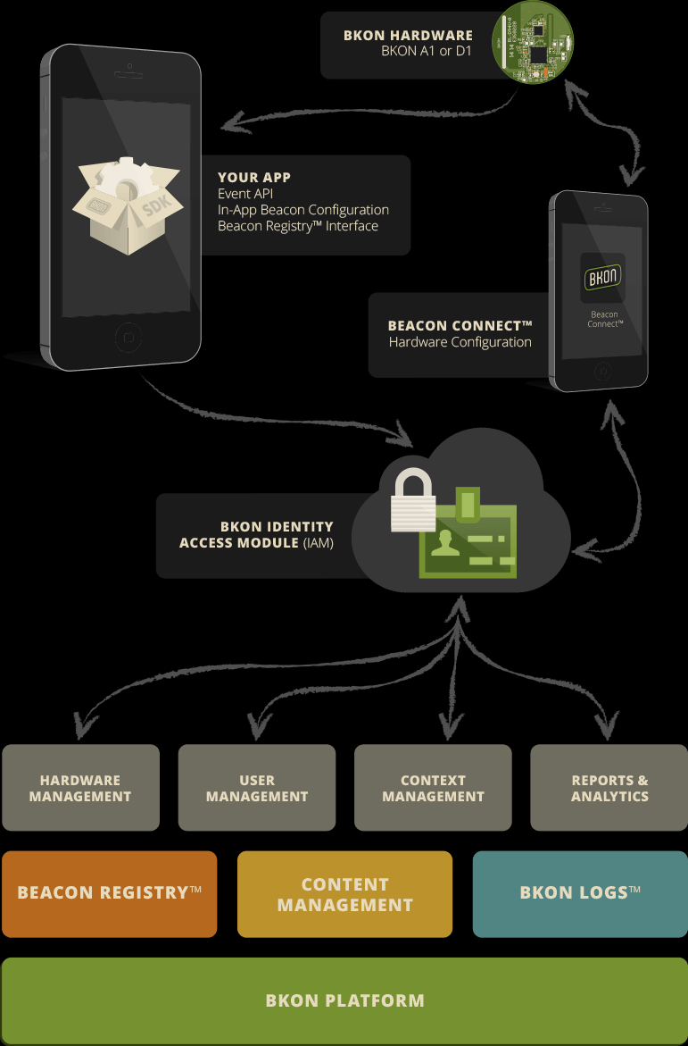
BKON platform
Register Beacons
Log Beacon presence
Manage hardware, users, and context
Reports & Analytics

Slide 11
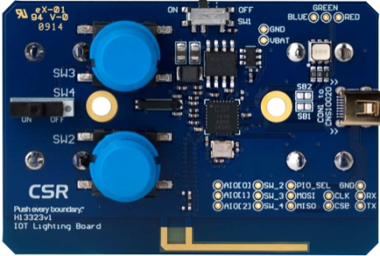
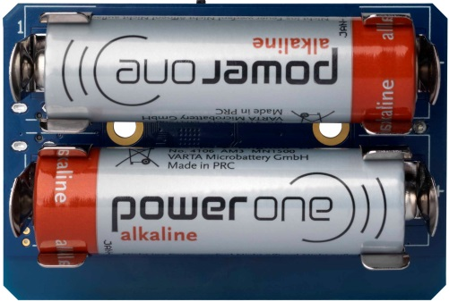
2nd Layer Smart Bluetooth Mesh Network
2nd Layer Device Network
Communicates with BKON Beacons and Gateway via mesh network
CSRmesh, a protocol running over Bluetooth Smart (formerly known as Bluetooth Low Energy).
CSRmesh™
Source: CSR plc.

Slide 12
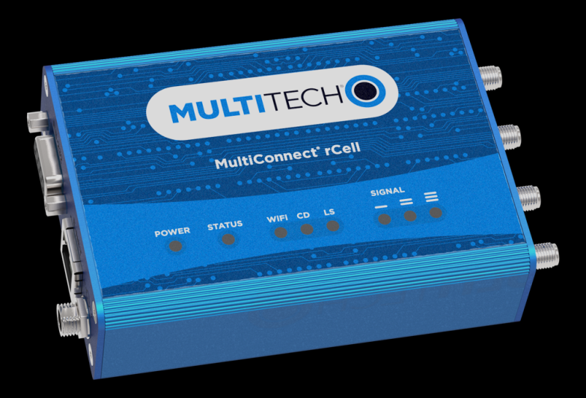
2nd Layer Gateway Device
Communicates with application platform
Takes in date from the BLE mesh network
Contains local custom software
OTA update capability
Cellular Router
MultiConnect® rCell 100 Series
Multi-Tech Systems

Slide 13
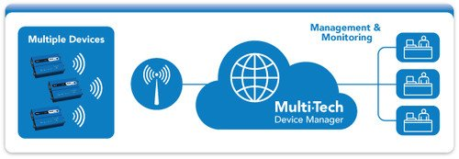
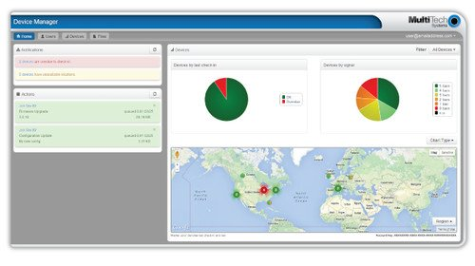
2nd device Layer Gateway
Manage devices with device portal
Source: Multi-Tech Systems

Slide 14
Business Model Monitoring and control service
Hospital asset and patient location and movement history information as a service
Generate monthly recurring revenue from each beacon point monitored by the service
Via portal customer can monitor:
Current location of patients and assets
Generate reports for location and movement of patients and assets
Add or remove beacons
Create asset and patient groups and hierarchies
Event types and flags

Slide 15
Business Model Monitoring and control service
Different hospital staffs generate own relevant custom reports.
Operational staff, Patient-attending, accounting, executive, maintenance, purchasing, etx
Bluetooth Low Energy (BLE) beacons enable the service platform to effectively monitor and report due to
Long life battery capability, small size, low cost, off-the-shelf availability, license-free & open-standard wireless technology
The customer base can be the hospital operator itself or 3rd parties such as equipment suppliers

Slide 16
Business Model 2nd Generation Model Monitor, Control and Optimization service
Higher value service optimized for KPI goals like:
Reducing cost, improving quality of service, improving revenue, based on historical movement algorithms of equipment and patients.
Minimize equipment inventories by improving efficient use, proper maintenance, higher availability, switching in/out, removing redundancy & underutilized equipment
Use in conjunction with equipment supplier arrangements to provide hospitals with equipment on a non-capital equipment basis

Slide 17
Business Model 3rd Generation Model Monitor, Control, Optimization, & Autonomize service
Integrate the service into other hospital systems such as accounting, facilities management, quality of service.
Self-coordinate with other systems to improve performance and reduce cost.
Coordinate the entire hospital can be as whole.
For example respond to demand changes, such as large emergencies where pre-planned responses are automatically launched that involve all systems of the hospital from the operating room to public relations.

Slide 18
Demonstration
https://raw.githubusercontent.com/xubinzheng/BlueCrew/master/Gif/BKONdemo.gif

Slide 19
Alternative Wireless Tech
Low Power Wide Area (LPWA)
Device transmission measured in miles with low power needs with low data rates and longer latency
3.1 bn connections by 2023 – Machina Research
Non-Cellular Networks
Sigfox –
Weightless
M2M Spectrum
Nuel`
Nwave
Semtech
Senaptic
Cellular Networks
LTE-A

Slide 20
BLE good and bad
Advantages
Relatively low power usage allows long battery life
Small footprint and volume
Uses license-free, non-proprietary wireless technology
No coding cost for BLE beacon
Simpleness limits feature creep
Disadvantages
Transmission limited to 30 meters
Requires 2nd layer of remote hardware
Installation cost and effort of 2nd layer may be prohibitive

Slide 21
MISTAKES TO AVOID
Adding functionality that customers don’t want to pay for.
Underestimating security and privacy risks.
Failing to anticipate new competitive threats.
Waiting too long to get started.

